Slide 1
JAWAHAR VIDYALAYA SENIOR SECONDARY SCHOOL
ASHOK NAGAR,CHENNAI
Financial Literacy course
Class: IX Session 3
TOPIC:FINANCIAL EXPENSES

Slide 2
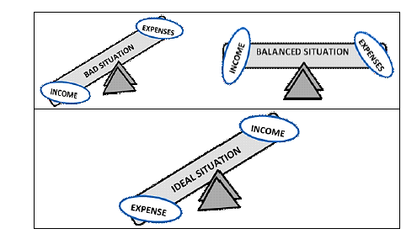
“Beware of little expenses. A small leak will sink a great ship.” –
Benjamin Franklin
"This is because, without understanding your expenses, your business operations / household management would remain incomplete. In fact, without incurring expenses, you would not be able to generate revenue from your business."

Slide 3
EXPENSES:DEFINITION
Expense is a type of expenditure that flows through the income statement and is deducted from revenue to arrive at net income.
An expense is simply a cost of a business.
Expenses are subtracted from revenues to determine profit on the income statement.
They often occur monthly and include bills such as rent, mortgage or car payments.
Some include HOA payments, insurance payments and professional association dues can also be due quarterly or annually

Slide 4
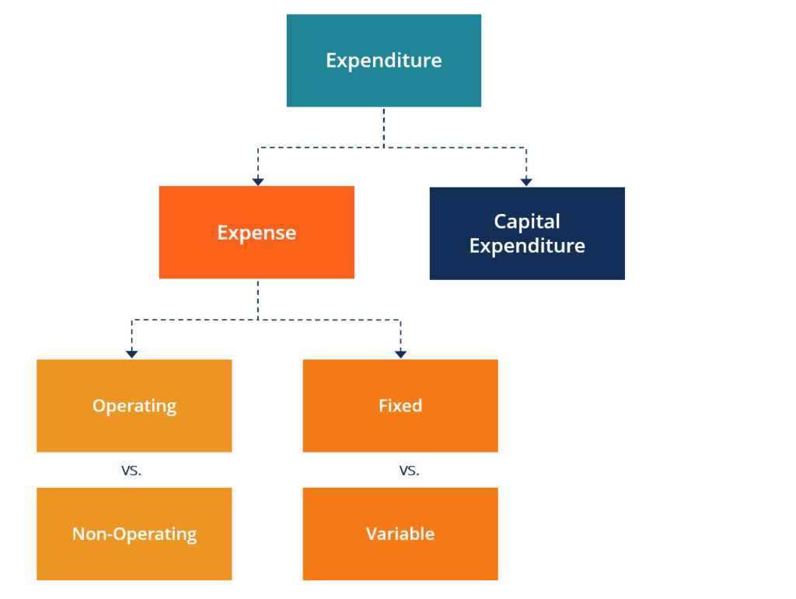
Expenses:Types

Slide 5
TYPES OF EXPENSES
Expenses fall into two basic categories.
cost of goods sold (COGS) or cost of services (COS).
It includes all the costs directly involved in producing a product or delivering a service.
2. The second expense category is operating expenses.
It includes the costs that are required to keep the business going day to day.
Total expenses for a given period =the sum of all the total gross cash expenditures plus any subsidiary pending,
A company may have considerable total revenues from its income statement

Slide 6
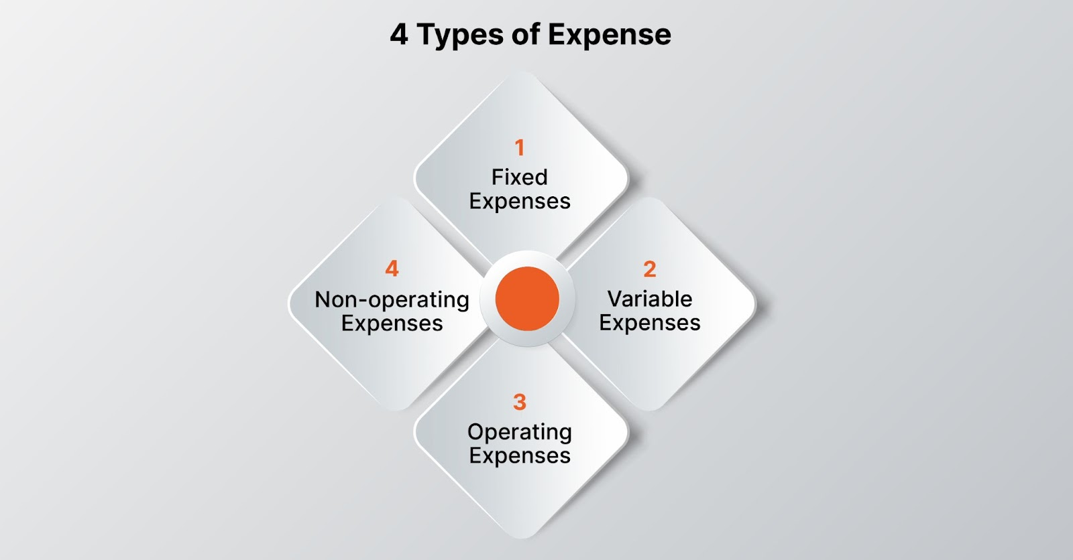

Slide 7
FIXED EXPENSES
Fixed expenses are steady costs that stay the same no matter how much a business sells or produces.
They’re like the backbone of a budget, always there whether business is booming or slow.
Example of Fixed Expenses
​​Rent: Monthly payments for leasing office space, retail space, or a manufacturing facility.
Salaries and Wages: Regular payments to employees, including base salaries and fixed wages for contracted workers.
Insurance Premiums: Regular payments for various types of insurance coverage, such as property insurance, liability insurance, or health insurance for employees.
Loan Payments: Monthly installments for business loans, including mortgages, equipment loans, and business lines of credit.
Depreciation: The gradual decrease in the value of assets such as buildings, machinery, or vehicles over time.
Utilities: Regular expenses for essential services like electricity, water, gas, and internet.
Lease Payments: Payments for leasing equipment, vehicles, or other assets under lease agreements.

Slide 8
VARIABLE EXPENSES
A variable expense is an expense that changes based on how much a company
produces or sells.
When production or sales increase, these costs also increase. Conversely, when
production or sales decrease, variable expenses also decrease.
They’re like the flexible part of a budget that fluctuates with business activity.
Identifying the Four Expense Types: Examples of Variable Expenses
Raw materials: The components needed to make a product.
Labor: Wages paid to workers involved in producing, packaging, or selling the product.
Utilities: Costs for essential services like electricity, water, and gas.
Commission: Payments to salespeople based on the number of products sold.
Distribution costs: Expenses related to shipping and delivering the product to customers.
Packaging materials: Materials used to package the product, such as boxes or labels.
Marketing expenses: Costs associated with advertising and promoting the product.

Slide 9
Expenses
Fixed Expenses | Variable Expenses
Fixed expenses do not change regardless of your spending habits or income fluctuations. (e.g.) Rent or mortgage payments Loan payments (student loans, car loans, etc.) Insurance premiums (health, car, home) Subscriptions (e.g., Netflix, gym memberships) | Variable expenses fluctuate based on usage or consumption (e.g.) Utility bills (electricity, water, gas) Groceries Transportation (fuel, public transit) Entertainment (e.g., dining out, movies) Medical expenses (if not covered by insurance)

Slide 10
OPERATING EXPENSES
The bills a company has to pay to keep its doors open and its wheels turning. They cover all the regular costs of doing business.
Operating expenses are the essential costs of doing business day in and day out.
Examples of Operating Expenses
Salaries and Wages
Rent
Utilities
Office Supplies
Insurance Premiums
Marketing and Advertising
Maintenance and Repairs
Travel Expenses
Professional Fees

Slide 11
NON-OPERATING EXPENSES
Non-operating expenses are costs a business incurs that aren’t directly related to its main operations.
These expenses can include one-time costs, like writing off old inventory or gains from selling assets that aren’t part of the core business.
Examples of Non-Operating Expenses
Write-offs
Restructuring costs
Legal settlements
Interest expense
Foreign exchange losses
Impairment charges
Gain or loss on asset disposal

Slide 12
Expenses
Operating Expenses | Non-operating Expenses
costs that are incurred in the day-to-day operations (e.g.) Payroll Insurance Research and development Inventory Equipment Rent Utilities Travel expenses | costs that are incurred through activities that are not necessarily associated with the firm's core operations. (e.g.) Interest payments on debt Restructuring costs Inventory write-offs Payments to settle lawsuits Losses from investments Losses on sale or write-off of assets Currency fluctuations Disasters

Slide 13
Expenses
Discretionary Expenses | Non-Discretionary Expenses
Money spent towards wants and desires. (e.g.) Eating out at restaurants Travel and vacations Luxury goods or services (designer clothing, gadgets) Hobbies and leisure activities (e.g., golfing, spa visits) | Money spent towards needs and responsibilities (e.g.) Basic healthcare (e.g., insurance premiums, doctor visits) Housing (rent or mortgage) Food and water Transportation (e.g., gas, car maintenance) Childcare or education costs

Slide 14
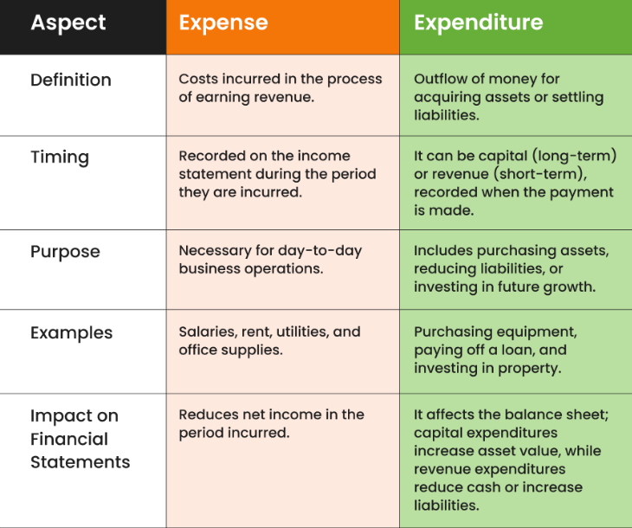
Expense vs. Expenditure

Slide 15
KEY TERMS
Budget : Estimated summary of income (money in) and expenses (money out) for a specific period of time (such as a week, month or year).
Income: Money that flows into your household (money in).
Expenses: Money you spend (money out).
Savings: To put aside money so that you can use it in the future.
Deficit: The money that is needed to cover expenses when expenses are greater than income. This is the amount that will either need to be pulled from savings or taken as a loan.
Surplus : The money remaining when income is greater than expenses.

Slide 16
Outlining expected income and planned spending
Item of expenditure | Amount (Rs.)
Food (35%) | 17500
Housing (20%) | 9000
Clothing (5%) | 2500
Family recreation (5%) | 2500
Household operations 5%) | 2500
Transportation (5%) | 2500
Education (16%) | 8000
Medical Expenses (3%) | 1500
Savings (8%) | 4000
Total | 50000

Slide 17
THANK YOU

