Slide 1
JAWAHARVIDYALA SNIOR SECONDARY SCHOOL
ASHOK NAGAR, CHENNAI
FINANCIAL LITERACY COURSE
BANKING
Borrowing, Accepting, Negotiating, and Keeping
CLASS:IX SESSION:5 Date:

Slide 2
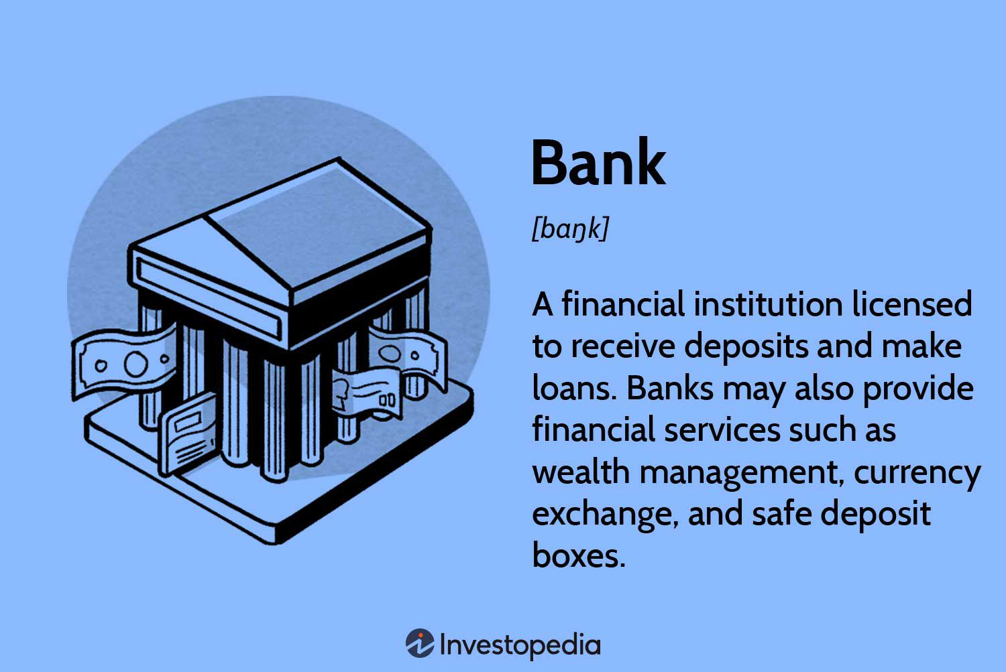
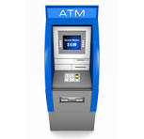
BANKING: ORIGIN AND DEFINITION
FINANCIAL SERVICES:
To assist a person with selling, borrowing or purchasing securities, allowing payments and settlements and lending and investing. They are Banking services, Insurance Services, Investment Services and Foreign exchange services
ORIGIN OF BANKING
In ancient human history, banking is said to have started in the temples and palaces of Babylonia even before 2000 BC.
Ancient Greeks too developed a system of transferring money in the form of book entries
. Banking in India started in a major way in the form of the Imperial Bank of India in 1921.
This was later renamed as the State Bank of India (SBI) in 1955.

Slide 3
Banking……
The central practice of banking consists of borrowing and lending.
Banks are a convenient and safe way to store excess cash and grow your money.
To create financial awareness on various financial products including deposit, loan, insurance,
and digital products
To enable general public to have better financial planning and help them inculcate the habit of
financial prudence.
The Indian banking system provides people with financial security for their funds.
It is done by offering loans at competitive rates, paying reliable remittance services, etc.

Slide 4
Bank: types
Banks are of different types and can be categorized on the basis of their ownership and services they offer
Central Bank:
Reserve Bank of India, abbreviated as RBI,
It is the central bank of India, and regulatory body responsible for regulation of the Indian banking system and Indian currency.
Owned by the Ministry of Finance, Government of India, it is responsible for the control, issue, and maintenance of the supply of the Indian rupee. I
t also manages the country's main payment systems and works to promote its economic development.
It plays a prominent role as the Central Bank of India and has the power to control the monetary situation of the entire country.
Implements monetary policies and Manages foreign exchange reserves
Acts as banker to the government and serves Financial regulation and supervision
Commercial Banks:
These include public sector banks owned by the Government and also the private banks.
Commercial banks provide a direct interface to the people allowing them to open and manage accounts, to obtain loans and other financial services.

Slide 5
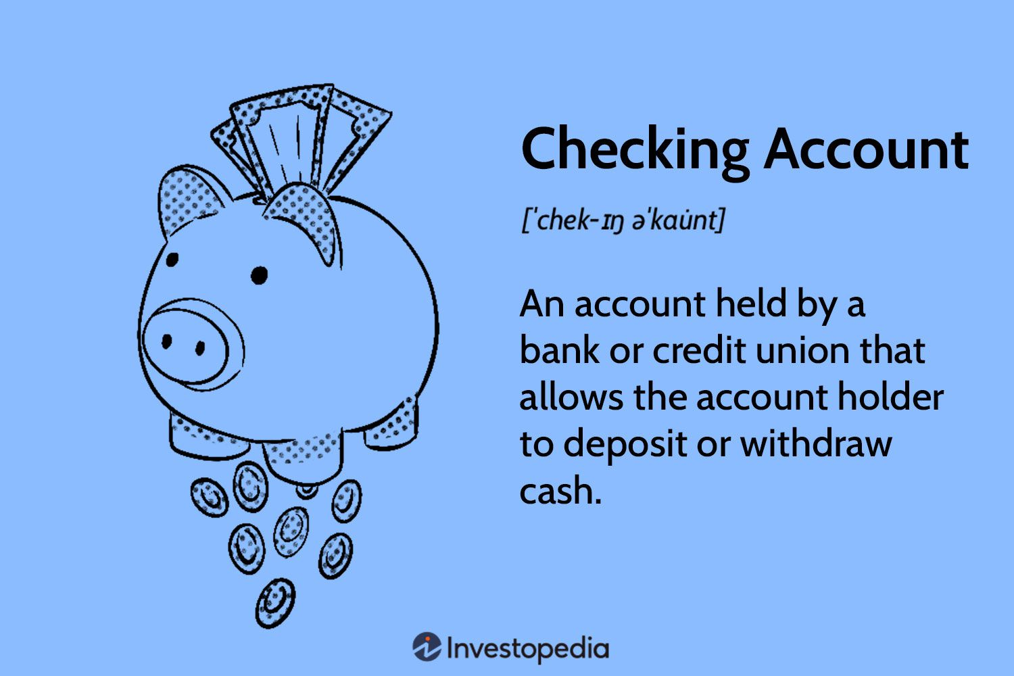
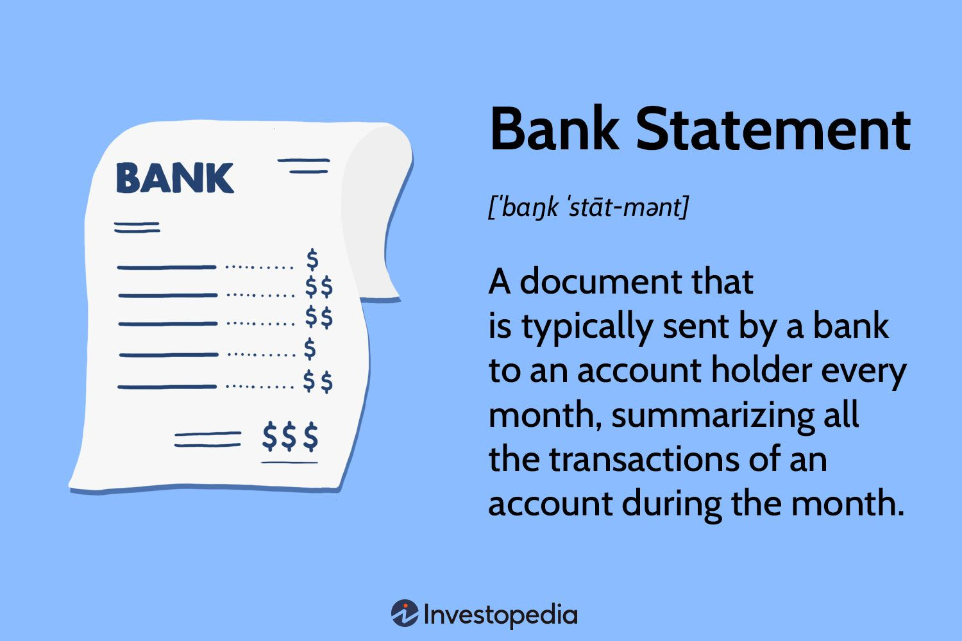
Banking Accounts
Types of Banking Accounts:
Current Account
Salary Account
Fixed Deposit Account
Recurring Deposit Account
DEMAT Account
NRI Accounts

Slide 6
TYPES OF BANK ACCOUNTS…..
Savings account:
These are the accounts opened in banks with the key purpose of inculcating the habit of saving among people.
Savings accounts allow maximum flexibility to deposit any amount of their liking, thus making it easy and convenient for common people.
This kind of account is popular with students, salaried individuals, and senior citizens. Savings accounts earn a nominal interest which is
based on the time period the funds are parked in the account.
Current Account:
These accounts are opened by business owners as they meet their requirement for an unlimited number of cash deposits and withdrawals.
The important thing to note in case of current accounts is that they do not earn interest. On the other hand, banks charge interest from account holders for an overdraft facility.
When banks allow account holders to withdraw more than their account balance in order to meet their business requirements, it is known as an overdraft
Fixed deposit:
This account type is ideal for depositors who wish to park their funds in the bank for a long period of time.
The key benefit of fixed deposit is that it provides a substantially higher rate of interest compared to savings accounts.
Recurring Deposit:
Very popular with students, recurring deposits are designed to encourage the habit of regular savings amongst people.
These deposits too earn interest higher than savings accounts. An example of a Recurring Deposit is when a depositor plans to deposit a fixed amount of Rs.1000 per month for a period of 24 months.
On the completion of the 24 months period, the depositor gets back the base amount of Rs. 24,000, along with the interest amount.

Slide 7
BANK ACCOUNTs
A Demat account, or Dematerialized account, is an electronic account that holds securities like shares, bonds, and mutual funds. It's similar to a bank account, but for storing financial securities instead of currency.It is an account for selling and buying securities
An NRI account is a bank account opened by a Non-Resident Indian (NRI) or a Person of Indian Origin (PIO).
Individuals can choose to deposit their earnings originating from a foreign country in an FCNR without such earnings undergoing conversion into INR. This facility allows NRIs to avoid exchange rate fluctuations and consequent reductions in the deposit value
Opening a Bank Account
A bank account can be opened in the name of an individual singly or jointly with a family member by submitting the following documents: • Passport size photographs • Identity proof • Address proof
The account holder will be given an account number in a pass book, cheque book and also they can enable Mobile banking
zero balance account (ZBA)
IT is an account in which a balance of zero is maintained by transferring funds to and from a master account.
ZBAs aren't consumer products but are used by larger businesses. An organization may have multiple zero balance subaccounts
There are situations when people may need funds more than their savings to purchase high-value products such as cars, bikes et cetera. In such situations, banks also provide ‘loan’ to the ‘deposit holders

Slide 8
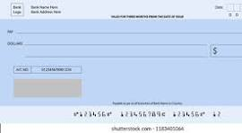
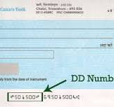
CHEQUE AND DEMAND DRAFTS
Cheque ﹘ an instrument of exchange Cheques have been the most popular instrument for money transfer for many decades.
Although today more and more people are using the option of online banking, yet cheques continue to remain at the very core of the banking industry.
Each cheque contains some key elements, which include:
● Name and signature of the person making the payment/account holder
● Name of the person who will receive the payment
● Date on or after which the cheque is valid

Slide 9
DIGITAL BANKING
Digital banking
It allows bank customers to avail banking services using the bank’s website on a laptop or through a mobile app on a smartphone/tablet. These services include:
• Checking account balance • Transferring funds to another account
• Ordering a cheque book • Changing passcodes
Do’s:
Keep your user ID and password confidential and do not reveal to anyone
• Memorize your user ID and password instead of noting down anywhere
• Log off completely and clear your system cache after every session
• Register for SMS alerts to keep track of transactions on your account
Don’ts
• Do not use an email message to log in to your banking account; Always use the official website
• Do not reveal personal information to anyone over email/SMS/phone call
• Do not use the ‘Remember Password’ feature provided by browsers to save your banking password

Slide 10
DIGITAL BANKING….
Digital Payments
It refers to transferring an amount of money to another individual, business or organization
through the internet without the requirement to handle physical cash.
Benefits of Digital Payments
Fast easy and convenient
One stop-solution: used for various purposes
Digital record ID secured
Transparent transactions:
Discourages involvement of black money

Slide 11
Modes of digital payments
Some modes of Digital payment include
Mobile wallets: A virtual wallet that stores your bank account or credit card information. You can add money to your wallet and use it to make payments. Some examples of mobile wallets include Paytm, Google Pay, and Apple Paye modes of digital payment include
E-banking: A digital payment system that allows you to manage your finances online. You can use it to make payments, transfers, and deposit
Unified Payments Interface (UPI): A system that allows you to combine multiple bank accounts into a single mobile app
Bank prepaid cards: A pre-loaded debit card issued by a bank. You can use it for single-use or reload it for multiple uses
Credit or debit cards: A popular way to make payments
Peer-to-peer (P2P) transfers: A way to transfer money directly to another person
QR code payments: A way to make payments using a QR code
Cryptocurrencies: A digital currency that can be used for payment

Slide 12
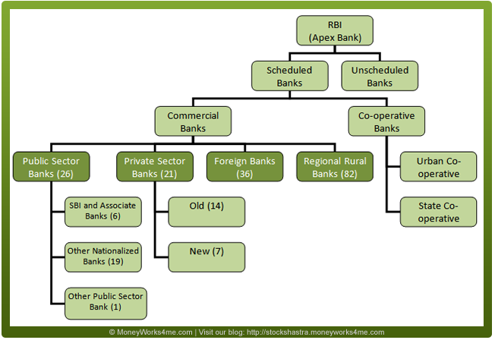
Banking system in India

